Slide 1



Becoming Rich
with
Recurrent Neural Networks
By Jakub Dylag

Slide 2


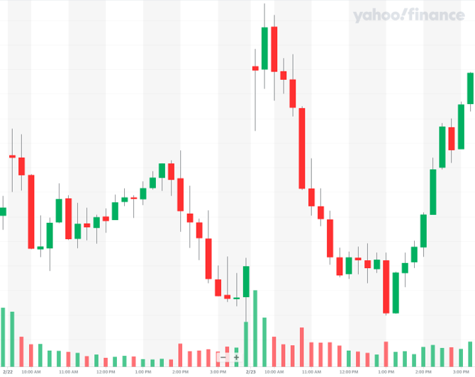


Microsoft (MSFT)
Where will the price go next?
Go up
B. Stay same
22nd Feb
23rd Feb
C. Go Down
D. Don’t Know

Slide 3
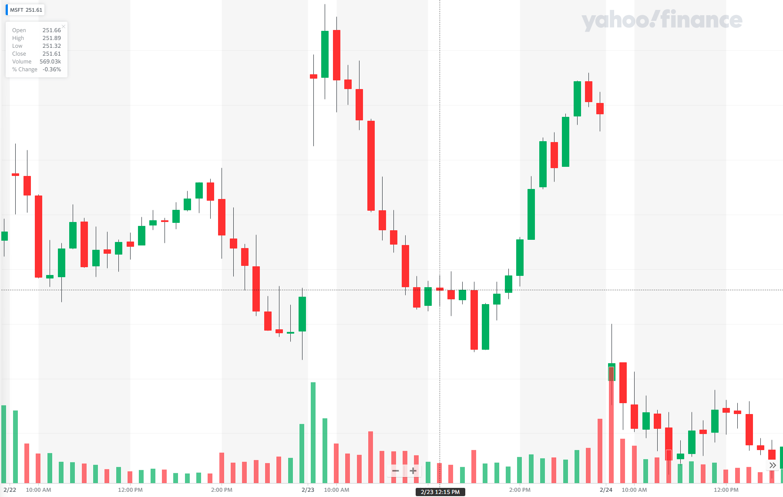

Microsoft (MSFT)
Where will the price go next?
Go up
B. Stay same
C. Go Down
Market manipulation 😝
22nd Feb
23rd Feb
24th Feb
D. Don’t Know

Slide 4

Why so hard?

Slide 5
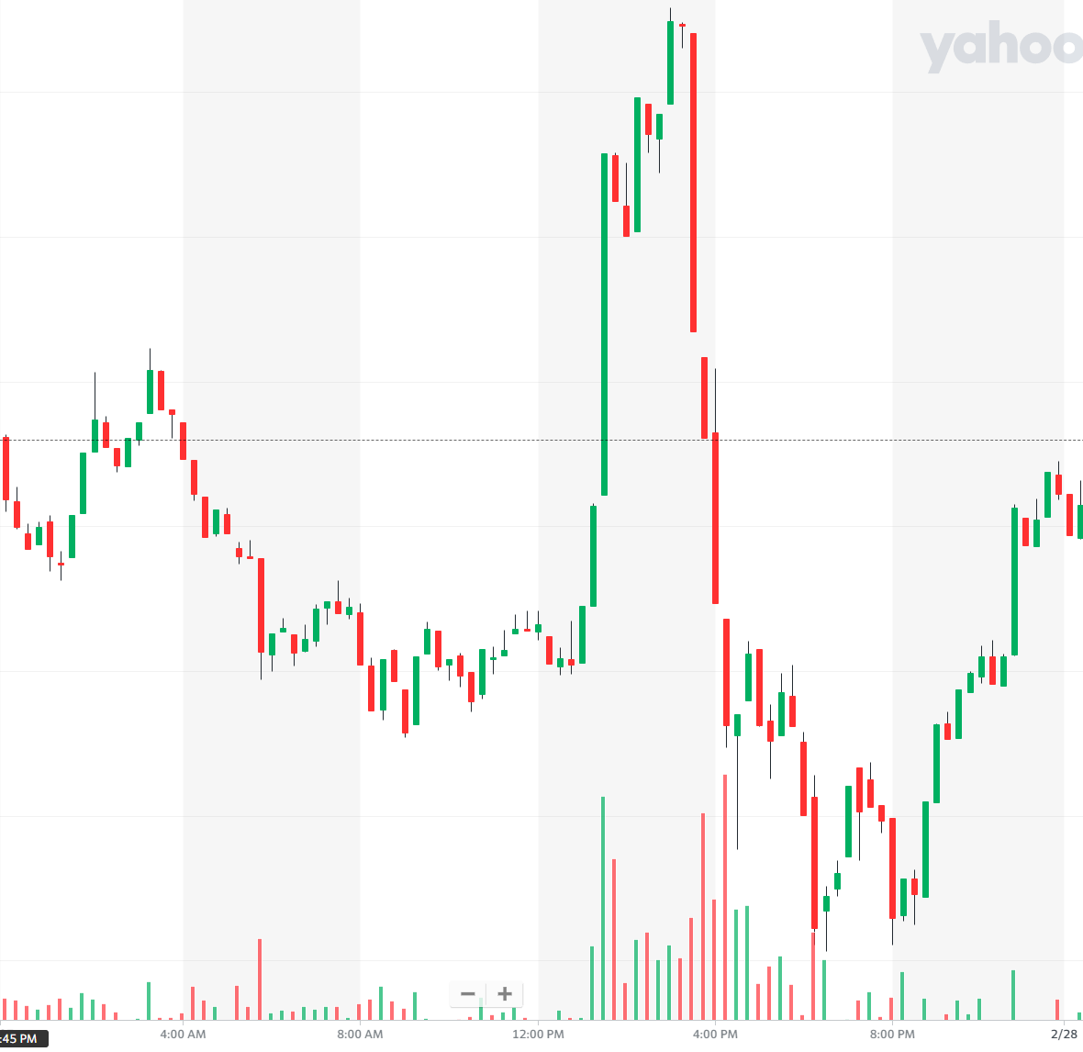
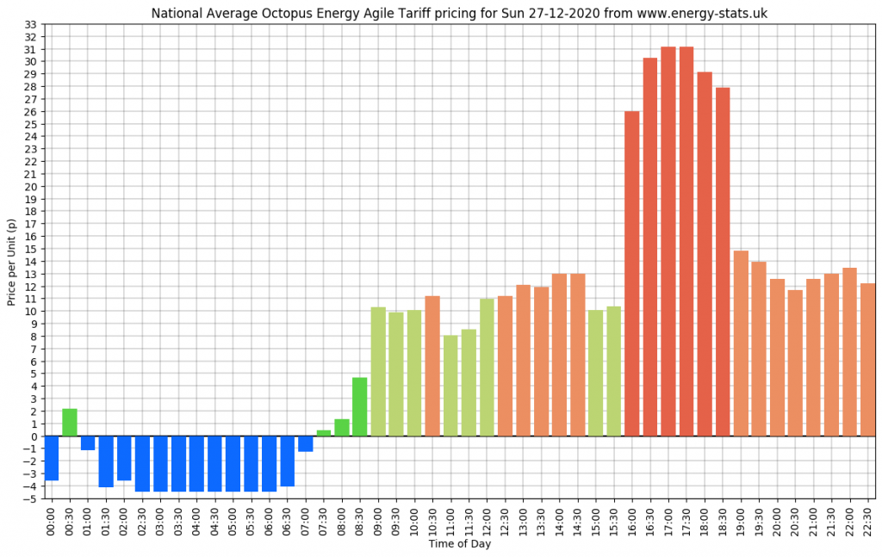
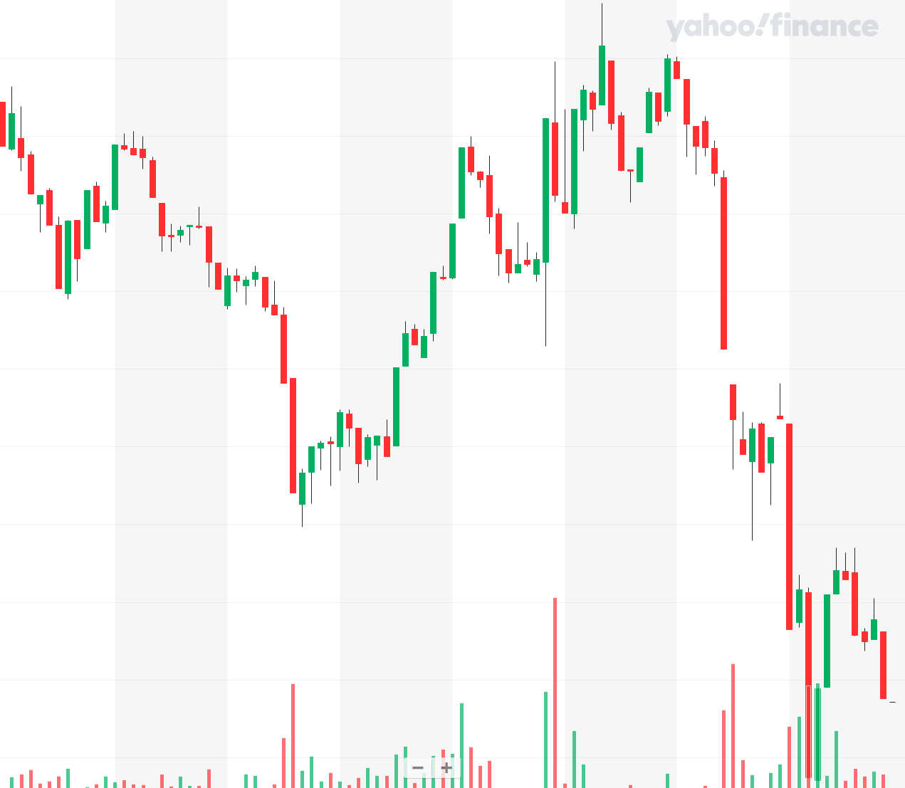
Problem: Electricity vs Stocks
Yesterday:
Bitcoin (BTC)
Octopus Energy UK
Today:

Slide 6


Slide 7
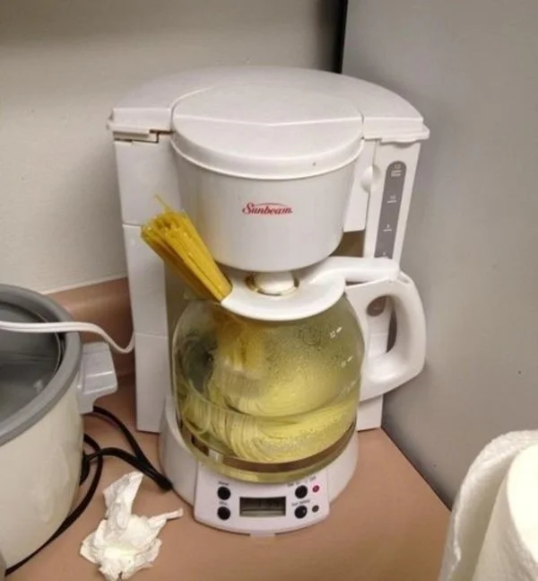
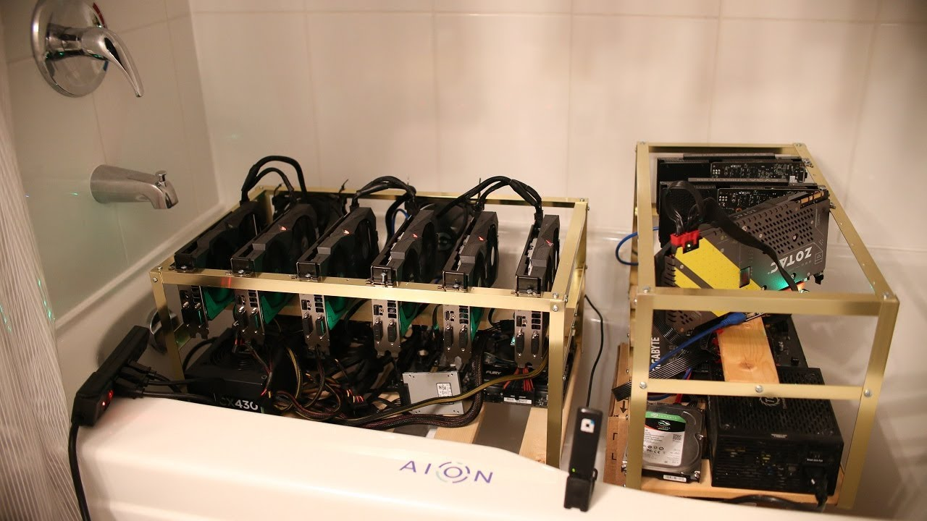

Save money by forecasting!

Slide 8
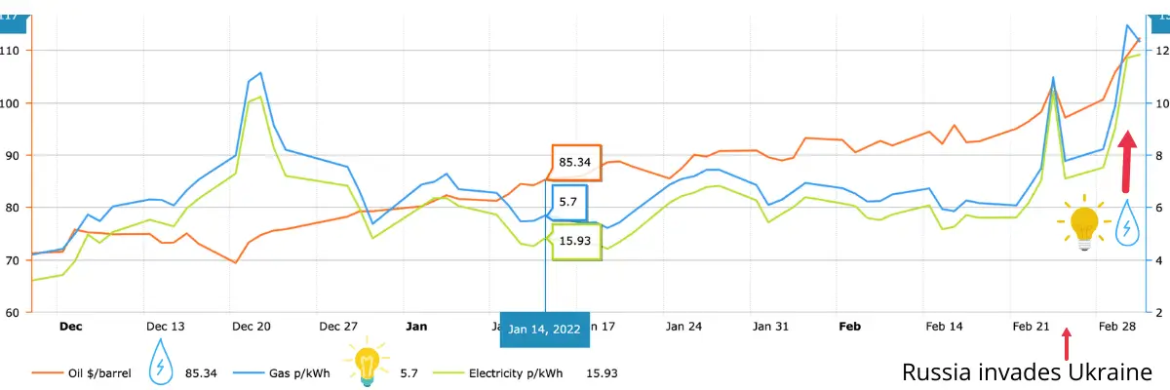
Timeseries Data
Octopus Energy provides a Historical Time-Series Dataset
Measurements every 30 mins
From February 2018 until Today!

Slide 9
Timeseries Data
Temporal data = timestamped at regular or irregular time intervals
Time-Series = ordered real-value measurements at regular time intervals

Slide 10
Timeseries Data Issues
Can Fix:
Gaps in Data
Interpolation – introduces synthetic data
Min Consecutive Length - split into defined lengths with no gaps
Cannot Fix:
Different measurement calibrations
Inconsistent time interval

Slide 11
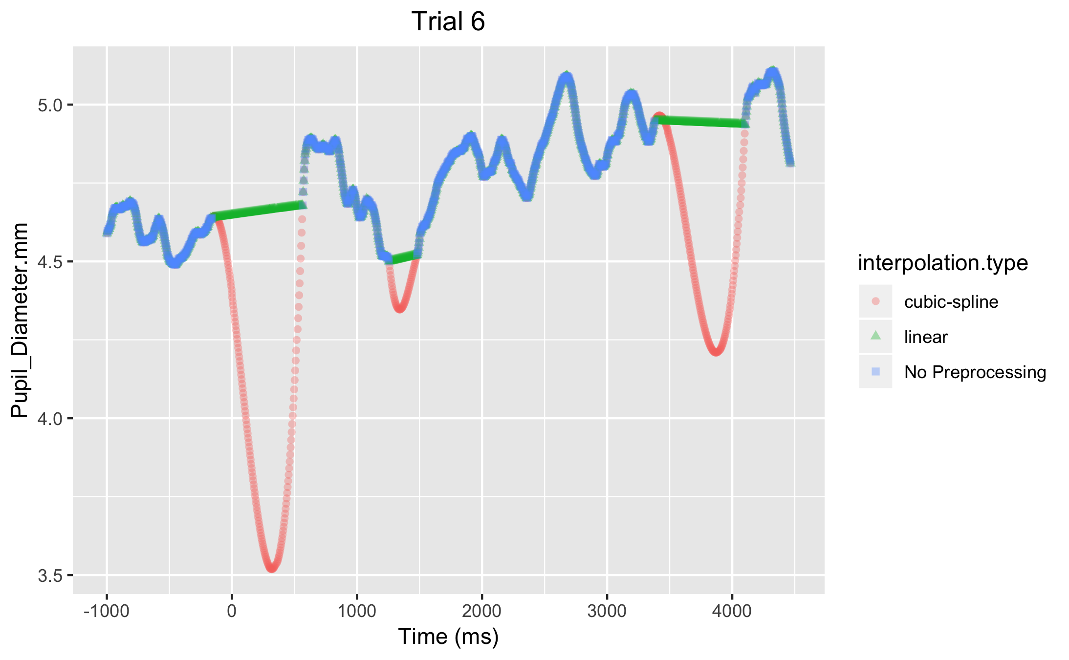
Pre-processing: Interpolation
Gaps in Data
Interpolation
Introduces synthetic data

Slide 12
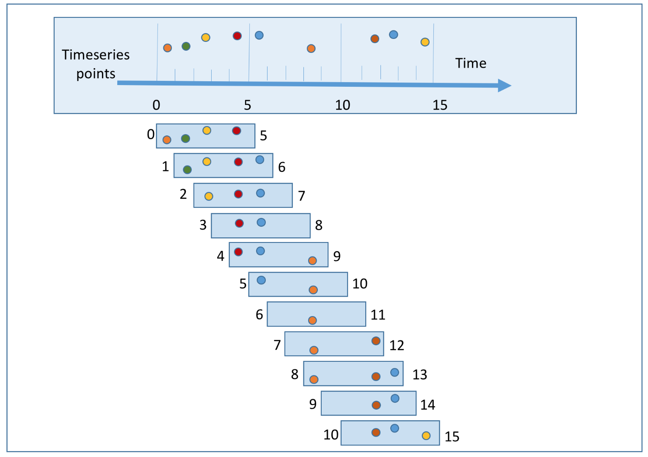
Pre-processing: Sliding Window
Gaps in data
Needs to be set size to input into our model
Step size = how far shift along
Repetition of Data may introduces overfitting

Slide 13
Recurrent Neural Networks (Elman Networks)

Slide 14


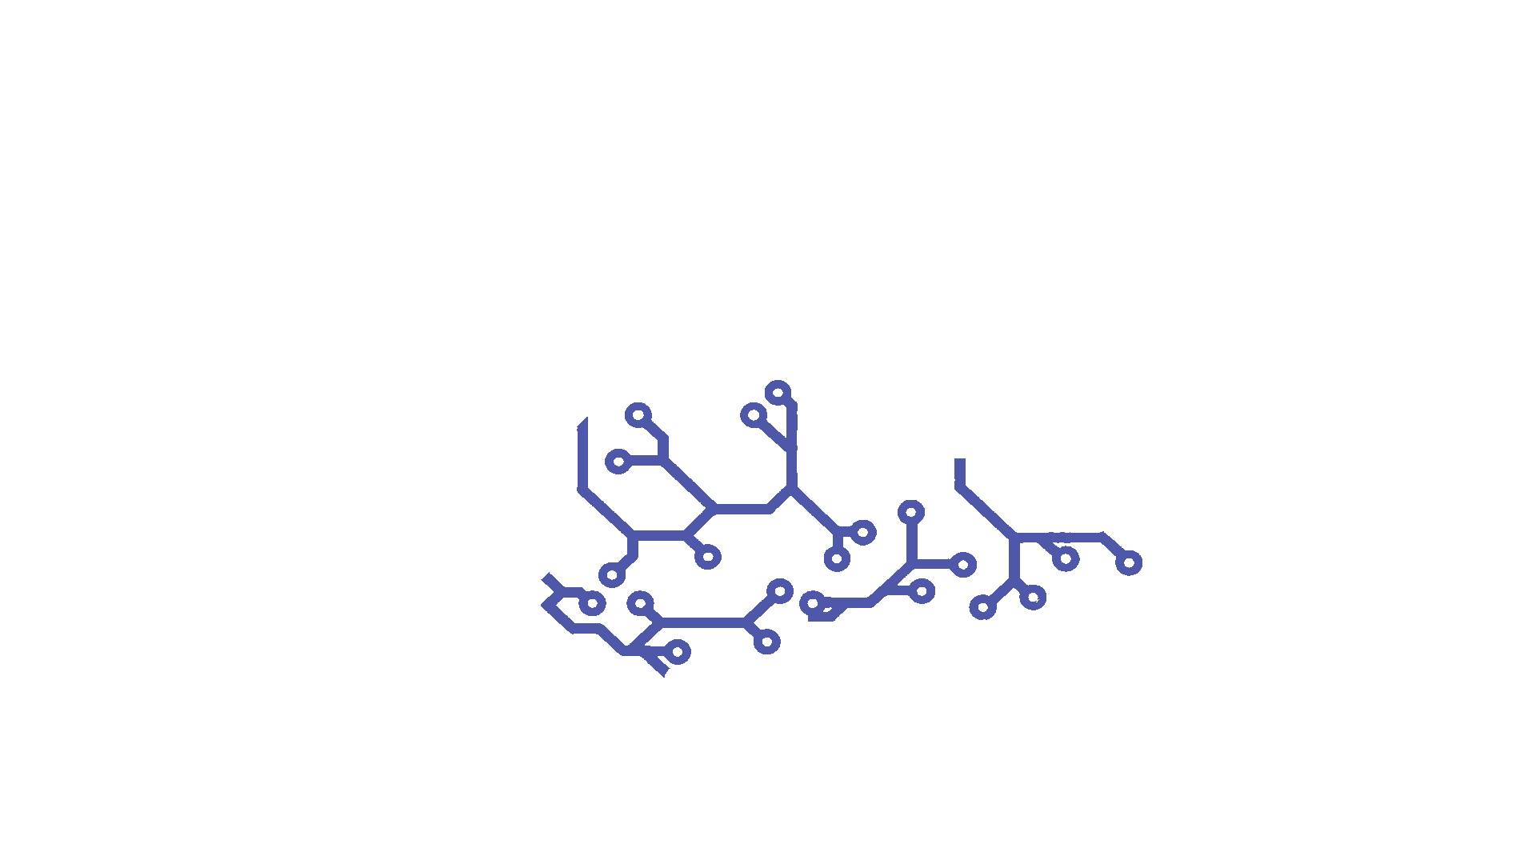



AI Brain
By Jakub J. Dylag
Parietal Lobe: Logistic Regression
Frontal Lobe: Neural Network
Temporal Lobe: Recurrent Neural Network
Hearing
Temporal data
Cerebellum: Decision Trees
Brain Stem: Linear Regression
Cerebrocerebellum: Random Forest

Slide 15

Recurrent Neural Networks (RNN)
Simplest form
Stepping stone to LSTM and Transformers (in article!)

Slide 16
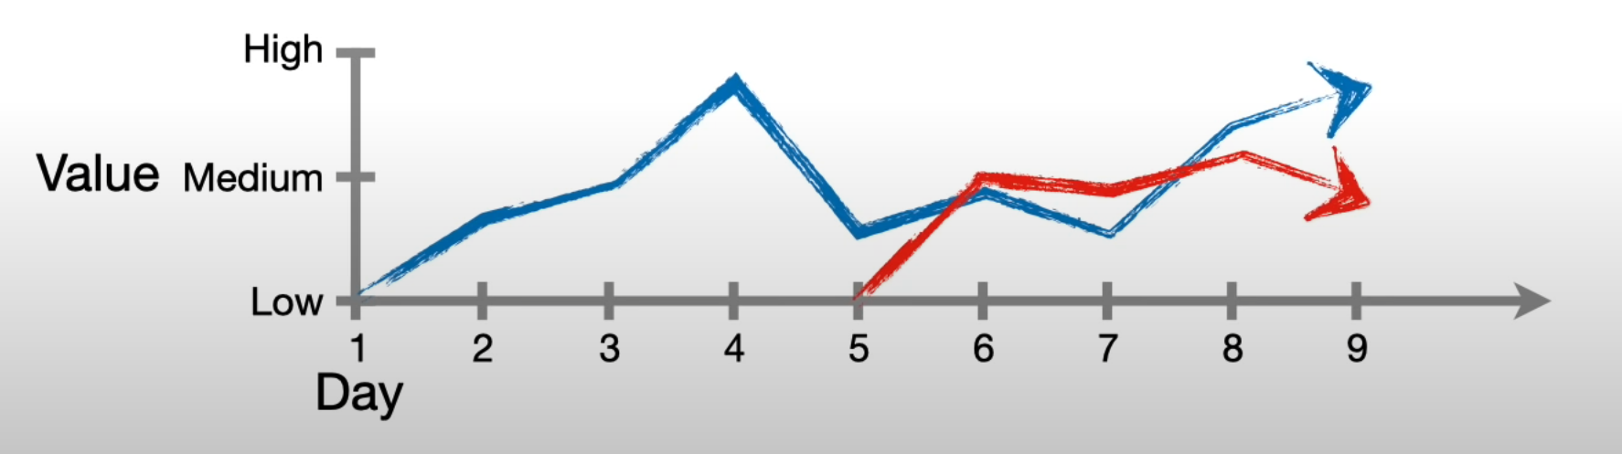
Flexibility
Can be flexible in amount of data given
Same Model for 9 values and 5 values

Slide 17
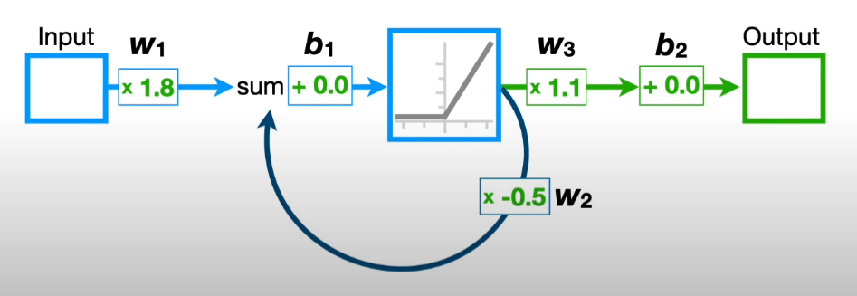
Same as Before
Weights
Biases
Activation Functions
Layers
Feedback Loop
Input is changed each run through

Slide 18
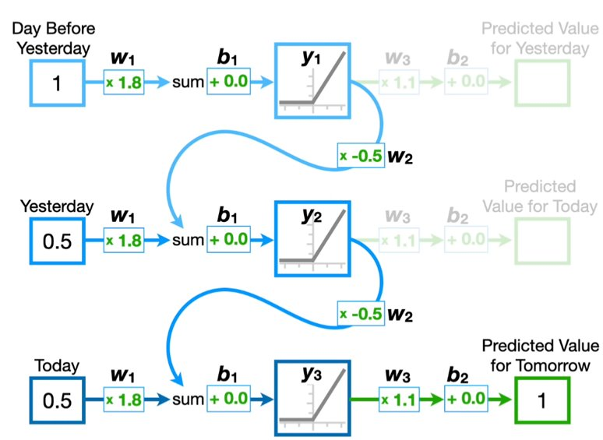
Example
“unrolled” view
New input each repetition
First output is useless as has no “yesterday”

Slide 19
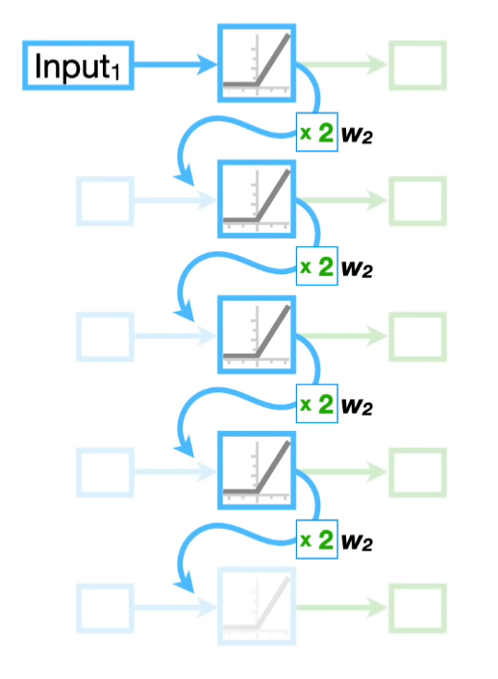
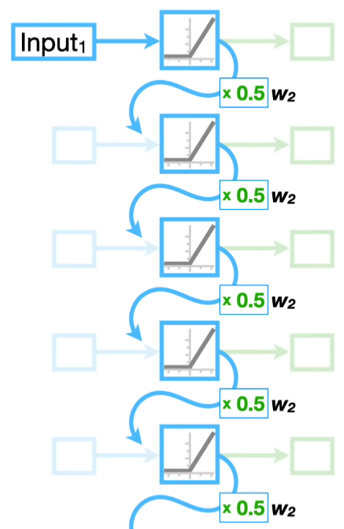


Vanishing Gradient Problem
The More “unrolls” the larger the error!
= 0
= HUGE

Slide 20

Questions?

Slide 21
<Coding/>

Slide 22

Github.com/aisoc/Workshops-22-23
Click on RNN folder

Slide 23
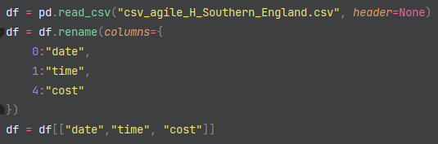
<Let’s Code/>
Import data using Pandas

Slide 24
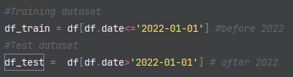
<Let’s Code/>
Train / Test split

Slide 25
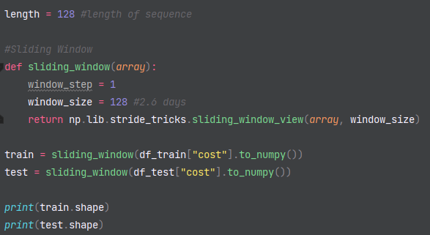
<Let’s Code/>
Although RNN can have any length – fixed size for training efficiency
Be doing Sliding Window Function

Slide 26
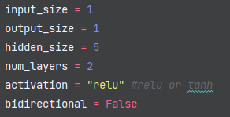
<Let’s Code/>
Choose Hyper-parameters:
Input size
Output Size
Hidden size
Num layers
Parameters = estimated from data
Hyper-parameters = manually set from by you (or ADAM)

Slide 27
Input and Output Size

Slide 28
Input Size = 1
Input 2
Input 1
Input 2
1, 2, 3, 4, 5, ... 123, 124, 125, 126, 127, 128
1

Slide 29
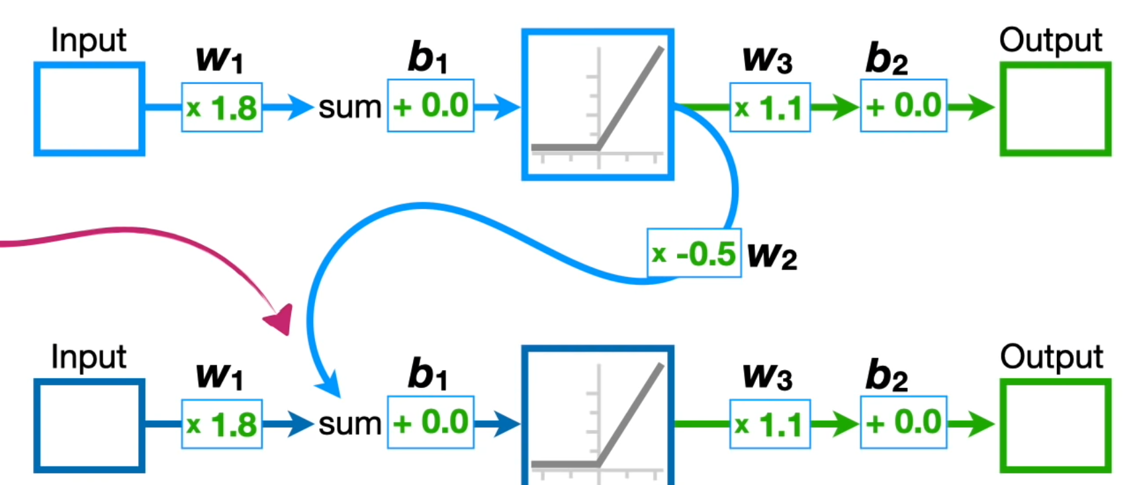
Input Size = 2
Input 2
Input 1
Input 2
1, 2, 3, 4, 5, ... 123, 124, 125, 126, 127, 128
1, 2, 3, 4, 5, ... 123, 124, 125, 126, 127, 128
Input 1
1
2

Slide 30
Input Size = 5+
Input 2
Input 1
Input 3
1, 2, 3, 4, 5, ... 123, 124, 125, 126, 127, 128
1, 2, 3, 4, 5, ... 123, 124, 125, 126, 127, 128
1, 2, 3, 4, 5, ... 123, 124, 125, 126, 127, 128
1, 2, 3, 4, 5, ... 123, 124, 125, 126, 127, 128
1
1, 2, 3, 4, 5, ... 123, 124, 125, 126, 127, 128
. . .
2
3
4
5

Slide 31
Output Size = 2
Input 1
Input 1
Output 1
1
1
2
Output 1
2
3
2
3

Slide 32
Hidden Size = 3
w1
w1, w2, w3

Slide 33
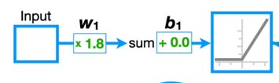
Number of Layers = 3

Slide 34
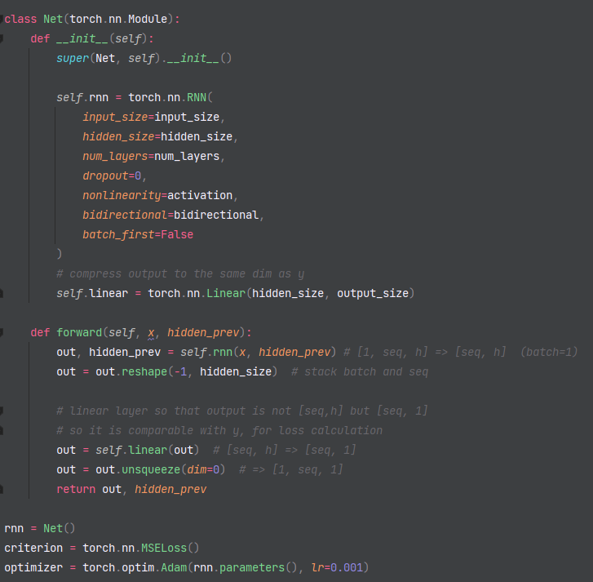
<Let’s Code/>
In PyTorch define model as class object
Use the inbuilt "RNN" and "Linear" Layers
Choose Loss function (MSE)
ADAM optimiser
Picks the best hyper-parameters for you!
e.g. Learning Rate

Slide 35

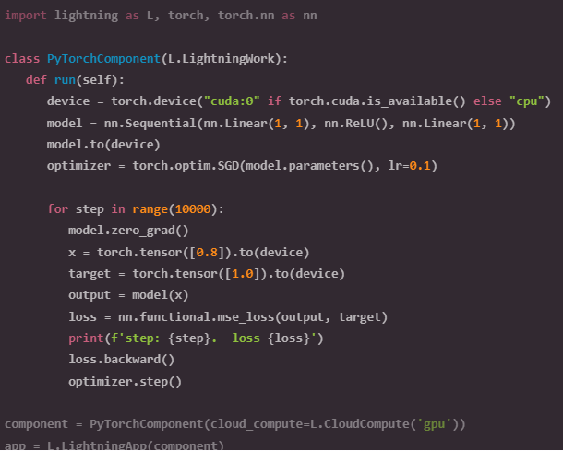
<Let’s Code/>
Use Lighting AI to scale your model!
Same code for CPU, GPU, GPU cluster and TPU
Whole model in one structure
Standardised
Sharing

Slide 36
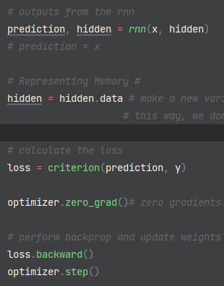
<Let’s Code/>
Training the Model!
Get a chunk of our training data (x) - Not shown
predict (y) and make a "copy" of hidden
Calculate loss
Backpropagation:
".backward()" - calculates our gradient
".step()" - updates all of them

Slide 37
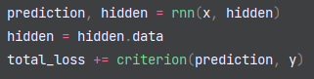
<Let’s Code/>
Testing the Model!
Get a chunk of our testing data (x) - Not shown
predict (y) and make a "copy" of hidden
Calculate loss
Backpropagation:
".backward()" - calculates our gradient
".step()" - updates all of them

Slide 38
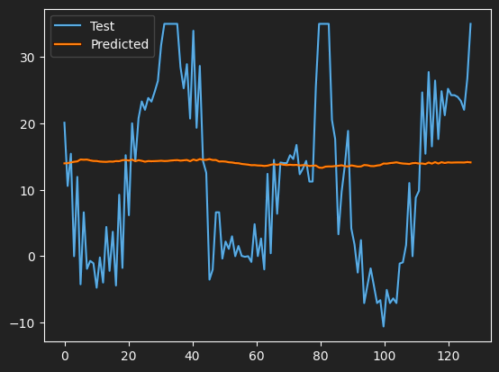

Could be better …
Suggestions?
Test Loss: MSE = 259.9876

Slide 39
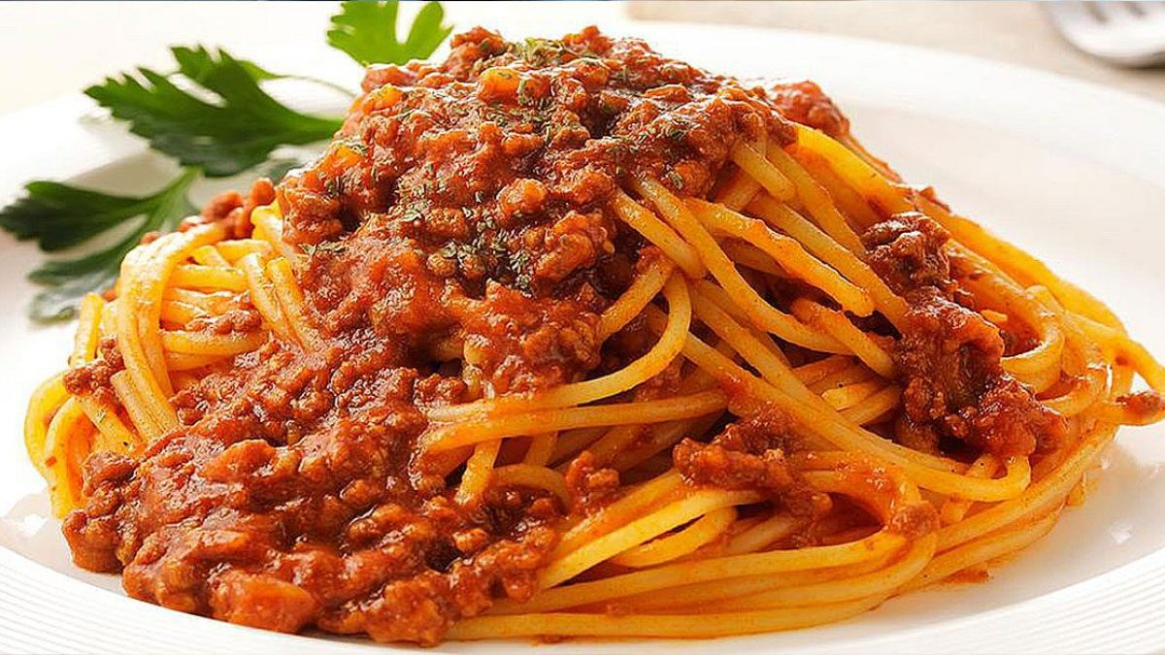

Saved money on your Bolognese!

Slide 40
Github.com/aisoc/Workshops-22-23
Click on RNN folder

Slide 41
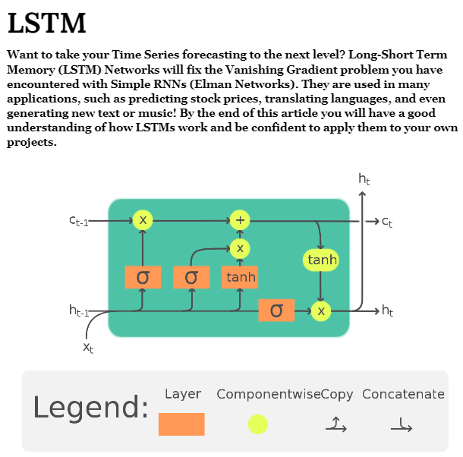
LSTM: www.aisoc.uk/wp-content/uploads/2023/03/LSTM.pdf

Slide 42


HACK AI Next week!
Psss … LSTM might be useful!

Slide 43
References
https://www.youtube.com/watch?v=AsNTP8Kwu80
https://www.energy-stats.uk/download-historical-pricing-data/
https://medium.com/dejunhuang/learning-day-27-implementing-rnn-in-pytorch-for-time-series-prediction-3ddb6190e83d

